Slide 1
Customer Churn Prediction System Using Machine Learning
End-to-End Churn Prediction and Deployment using Machine Learning
By: Ankit Kumar Singh

Slide 2
Problem Statement
Customer churn is a problem that many businesses are facing right now, and losing customers can result in a loss of revenue and stunted growth. To avoid this, businesses need a system to anticipate which customers are most likely to churn, and to act to prevent it before it happens. In this project we will build a machine learning model to predict customer churn, using a variety of behavioral and demographic features. In this project, we aim to build a machine learning model that

Slide 3
Solution
Content:
Developed a Machine Learning model to predict customer churn
Uses customer data such as usage patterns, support calls, and payment behavior
Identifies high-risk customers before they leave
Enables businesses to take proactive actions like offers and support
Deployed using Streamlit for real-time prediction

Slide 4
Dataset Overview
The dataset consists of customer demographic and behavioral information It includes key features such as: Demographics: Age, Gender
Usage Patterns: Tenure, Usage Frequency
Customer Behavior: Support Calls, Payment Delay
Subscription Details: Subscription Type, Contract Length
Financial Information: Total Spend, Last Interaction
Target Variable: Churn
0 → No Churn
1 → Churn

Slide 5
Methodology
Performed data preprocessing by handling missing values and removing irrelevant features
Conducted Exploratory Data Analysis (EDA) to understand data patterns and relationships
Applied feature engineering techniques including encoding of categorical variables
Split the dataset into training, validation, and testing sets
Trained multiple machine learning models and compared their performance
Evaluated models using metrics such as accuracy, precision, recall, and F1-score
Deployed the final model using Streamlit for real-time prediction

Slide 6
Key Insights
The dataset exhibits class imbalance in the churn distribution
Customers with monthly contracts show a higher tendency to churn
An increased number of support calls is strongly associated with higher churn rates
Payment delays significantly contribute to customer churn
Customers with lower tenure are more likely to leave the service

Slide 7
Models Used
Logistic Regression
Naive Bayes
K-Nearest Neighbors (KNN)
Decision Tree
Random Forest

Slide 8
Hyperparameter Tuning
Performed hyperparameter tuning to improve model performance
Used GridSearchCV to find optimal parameter combinations
Tuned key parameters for different models:
Logistic Regression: Regularization strength (C), max iterations
KNN: Number of neighbors, distance weighting
Decision Tree: Tree depth, minimum samples split
Random Forest: Number of estimators, depth, split criteria
Selected the best parameters based on F1-score and cross-validation

Slide 9
Model Performance
valuated models using multiple performance metrics
Random Forest achieved the best overall performance
Accuracy: 94%
Precision: 0.90
Recall: 1.00
F1-score: 0.95

Slide 10
Confusion Matrix
The model achieves a high number of True Positives, indicating strong churn detection
The number of False Negatives is very low, meaning most churn customers are correctly identified
Some False Positives are observed, which may lead to unnecessary retention actions

Slide 11
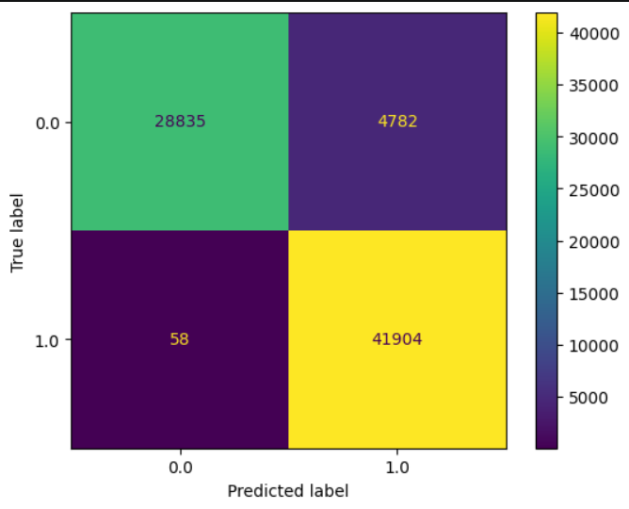
Confusion Matrix

Slide 12
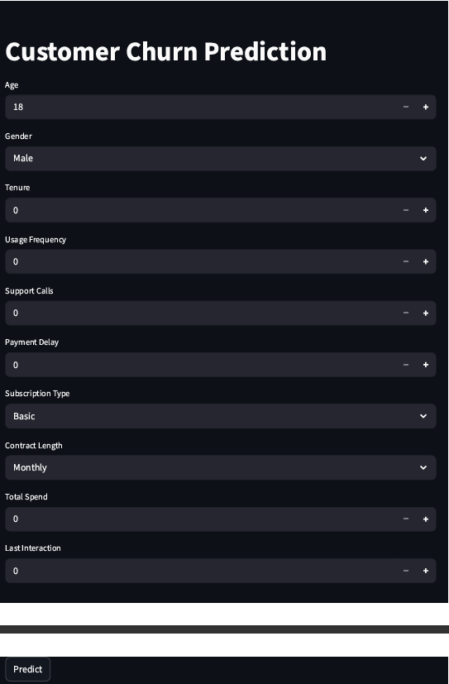
Streamlit Application

Slide 13
Deployment (Streamlit Application)
The trained machine learning model was deployed using Streamlit
An interactive user interface was developed for easy input of customer data
The application processes user inputs and applies the trained model for prediction
Provides real-time churn prediction along with probability
Designed to be simple, efficient, and user-friendly

Slide 14
Conclusion
Successfully developed a machine learning model to predict customer churn
Random Forest achieved the best performance among all models
The model demonstrates strong ability to identify churn customers
Deployed the model using Streamlit for real-time prediction
The solution can help businesses improve customer retention strategies

